Slide 1
Assets & Reserves Continuing the Capital Planning Journey
Melissa B. Gordon
Chief Operating Officer
Katana Software, Inc.
mgordon@katanasoft.com
Michelle Taddei
Operations Manager
Katana Software, Inc.
mtaddei@katanasoft.com

Slide 2
Defining the Vision
Persistently Accurate Asset & Reserve Data (Asgard)
Visualize upcoming budget and PM/staff impacts
Consistent standard of care for Assets
Maximize asset useful life
Fewer surprises to Owners
Management Company value/revenue

Slide 3
Documenting/Understanding the Historical Reserve Study Process
Static Process

Slide 4
Documenting/Understanding an Enhanced Reserve Study Process
“Living” Process
Site engages Reserve Preparer to perform a Reserve Study
DOF is responsible for ongoing updates to the latest reserve study
DOE engages consultants for the following assessments (Roofing, Mechanical, Elevators, Structural)
Coordinate comprehensive consultant review of the high impact categories for each site
Reconcile Asgard and Reserve Preparer databases and restrict editing
Perform interval updates when new information becomes available

Slide 5
Documenting/Understanding the Asset & Reserve “Universe”

Slide 6
Implementing Effective, Integrated Processes
Multi-year Review of Asset & Reserve Data in Asgard
Annual Project Management for CAPEX projects
Daily Management of the total Asset Lifecycle

Slide 7
Reviewing Data in Asgard for Accuracy
Standard Reports
New visualizations

Slide 8
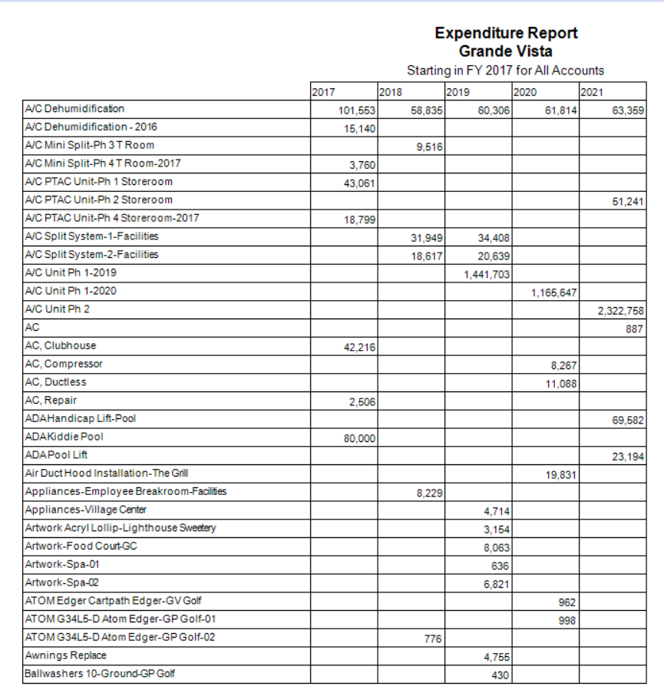
Standard Reports Expenditure Summary Report
Accessible from:
Account List > Reports > Ideal Balance and Funding > Expenditure Summary
List of Asset Types, Organized by Planned Replacement/Expenditure Years

Slide 9
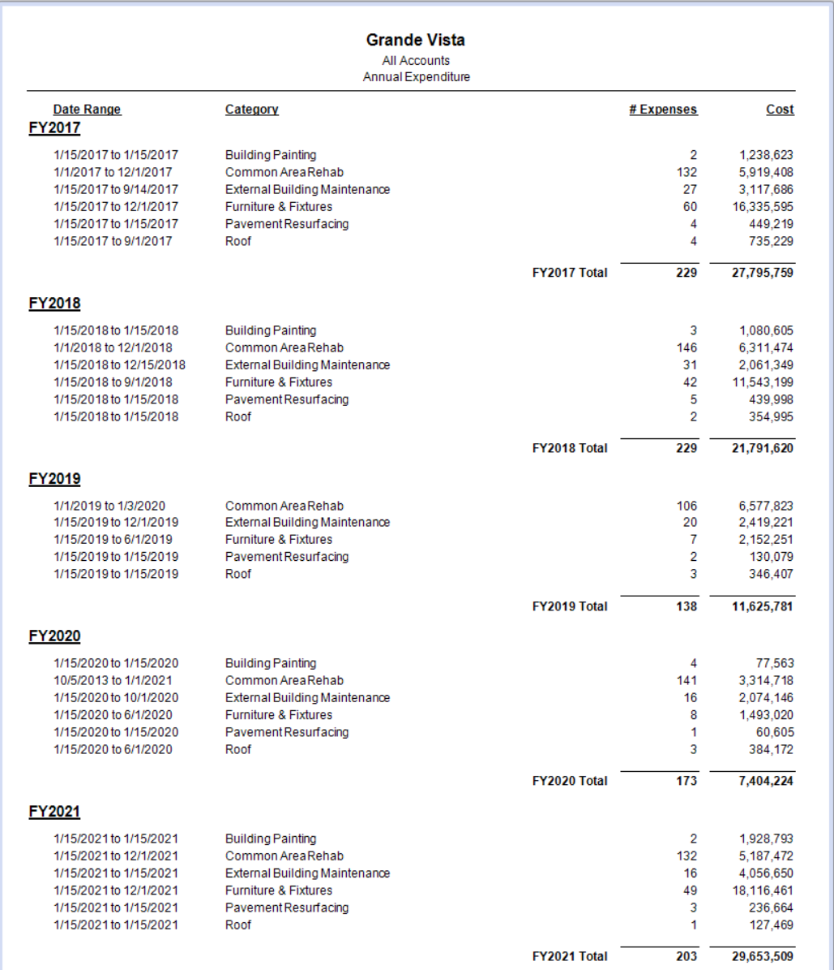
Standard Reports Annual Expenditure Report
Accessible from:
Account List > Reports > Ideal Balance and Funding > Annual Expenditure
List of Asset Types, Organized by Planned Replacement/Expenditure Years

Slide 10
Asset Detail Research
Asset Categories – Useful when you know the Category, or are interested in a summary of multiple Types
Asset Types List – Useful when you don’t need/know the Category, and are interested in a specific Asset Type
Asset Search – When you only know keywords
Asset Category
(Fitness)
Asset Type
(Cardio Equipment)
Asset Type
(Weight Machine)
Asset Instance
(Machine 1)

Slide 11
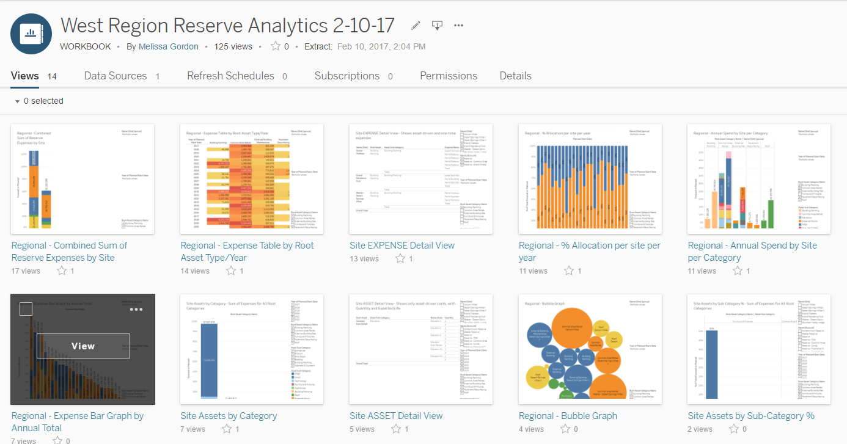
New Tools

Slide 12
Annual Project Management for CAPEX
Using the data to proactively identify anomalies
Under/over-budget for planned projects
Smoothing the budget – High-impact years
Changes in the operating environment
New needs
Identifying sub-market opportunities and vendor relationship opportunities
Determining Project Management Strategy

Slide 13
What will my Capital Expenditures Look like for the next 30 Years?

Slide 14
Managing the total Asset Lifecycle
Working with Katana/Asgard to update assets
Adding new PM and Inspections programs
Monitoring for threats to the asset’s planned lifecycle
Integration of other asset data (e.g. EMS data)

Slide 15
Scenario 1 – Asset Access
Help! I can’t even access those tabs in Asgard!
What to Do
Contact support@katanasoft.com with the request for additional permissions to view assets.
Include your title in the request, to ensure there are no delays in approval.

Slide 16
Scenario 2 – Asset Updates
Help! My asset/reserve data doesn’t make sense or is inaccurate!
Sample Situations
Asset scheduled for the incorrect year, or adjusted during annual review
Asset’s useful life is not adjusted to the specific site conditions/use
Specific line items are scheduled for interval years often not in the proper order causing reduced life cycles or a missed opportunity to leverage the spend. (window replacements/exterior paints, mechanical system retrofits)
The estimates are often driven off of industry standards not competitively bid estimates that incorporating market specific conditions.

Slide 17
Scenario 2 – Asset Updates
Help! My asset/reserve data doesn’t make sense or is inaccurate!
What to Do
Report any issues to the DOF, to be updated in Asgard
Confirm that the associated PM information is accurate in Asgard

Slide 18
Scenario 3 – Asset Replacement
I got a new, major asset! Now, what?
What to Do
Confirm that the asset data is accurate in the budget, with the DOF
Confirm that the asset has an appropriate PM Template/Schedule
After 30 and 60 days, pull work orders for the asset to confirm performance

Slide 19
The right information in the right hands, at the right time, presented in the most compelling way, yields incredibly golden results. But, even the right information presented too late, to the wrong people, or with too much complexity will not create business value.
For further questions, inspiration, or assistance contact mgordon@katanasoft.com

