Slide 1
Housekeeping Management Inspections
Improving Team Outcomes with Asgard
Melissa B. Gordon
Chief Operating Officer
Katana Software, Inc.
mgordon@katanasoft.com
Michelle Taddei
Operations Manager
Katana Software, Inc.
mtaddei@katanasoft.com

Slide 2
Housekeeping Inspections Journey
Implemented Inspections Work Orders in Asgard
Enhanced Dashboards to Track Failed Tasks and Scores
New Opportunity: Analytics
Added Standard Templates

Slide 3
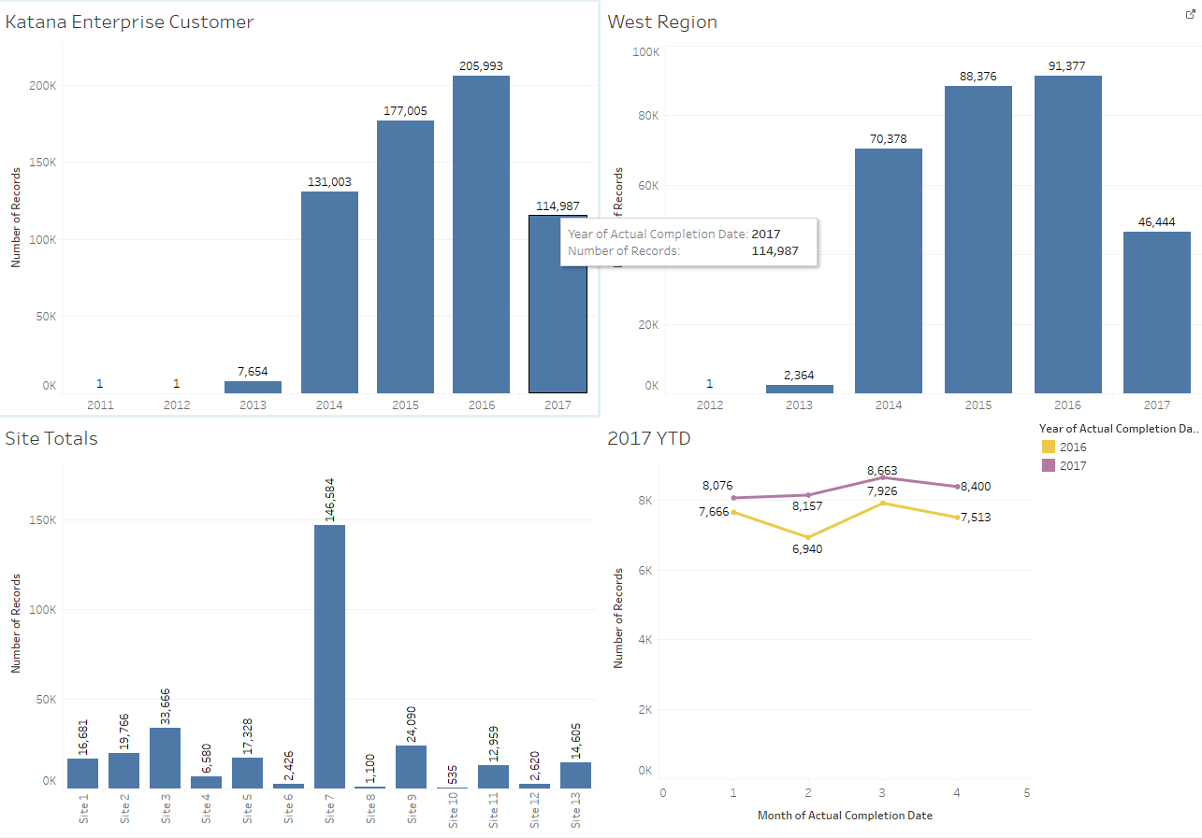
Housekeeping Inspections Journey Volume since Inception

Slide 4
What Opportunities Does the Success of the Program Create?
How can we leverage this volume of Inspections data, to derive new insights?

Slide 5
What are the Challenges?
Some sites still have room to grow/fully implement Inspections.
We are using Asgard to gather data we aren’t fully utilizing.
It takes too long to format the data to be actionable and/or report logic not understood
Reports in PDF or Tabular Format
We can’t easily “slice and dice” the formatted data to be actionable without IT
We don’t know what we don’t know…
…And, what we do know, we can’t operationalize.

Slide 6
Diverse Users, Diverse Needs
Department Managers
Timely, Specific/Targeted
They are concerned with Accountability
Resort Managers
Timely, Comparable, Fair
They are concerned with Analysis

Slide 7
What’s the solution?
“Single Pane of Glass” Dashboard for the most critical areas of business value
What is a “Single Pane” solution”?
Tool to answer a complex business proposition, simply
For example:
Are we okay right now?
Will we be profitable this period?
What do owners want?
Requires shared business definition of underlying terms/concepts
Doesn’t mean that there is only one dashboard at all, but that there is one place to gather all of the information needed to address a specific business question

Slide 8
Embarking on the Dashboard Journey
How can your systems be used to manage, monitor, and drive the outcomes?
Visualize your universe
What sources of data are available/needed? (Inputs and Outputs)
How can the data be moved/accessed?
What platforms are available/needed?
Identify user communities need to be involved to make the project a success
Line staff to understand tactical measures
Resort leadership to understand strategic goals
IT staff or Vendor to understand technical impediments/opportunities
Test your solution

Slide 9
Key Features of Powerful Dashboards
Combines all needed data in one place
Tells the story (colors, size, etc.)
Offers one-click “slice and dice” by meaningful segments
Village / Zone / Building / Team
In-Source versus Third-Party Labor
Guest Type
Day of the week, hour of the day, etc.
Suggests AND supports drill-down capabilities

Slide 10
Are we adequately staffed in Housekeeping?

Slide 11
New Associate Dashboard

Slide 12
Filter by critical data points, to use the dashboard to view by Inspectors OR Inspectees

Slide 13
View work order and task-level data, side-by-side

Slide 14
Test the Solution
Layered, Numerous Display Options
Interactive: Hover-Over, Filter, Drill-Down Capabilities
Mobile-Friendly, Accessible Anywhere
End-User Accessible and Customizable
Secure
Next Steps / Call to Action
Test/Use the new Associate Dashboard
Submit ideas for further improvements and enhancements

Slide 15
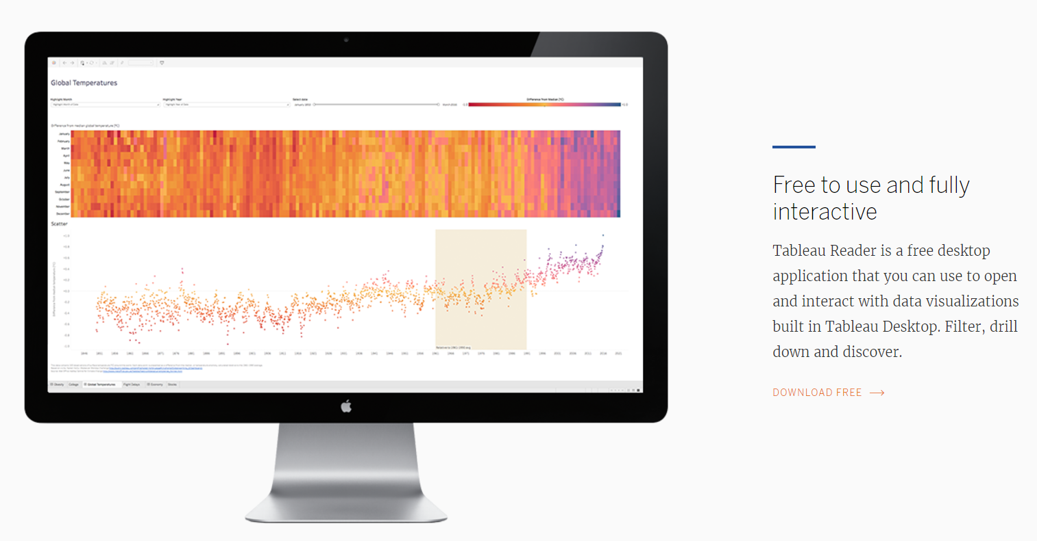
Next Steps Update on Installation of Tableau Reader

Slide 16
Next Steps Brainstorming Dashboard Concepts
Can the findings be leveraged to crush costs, increase revenue, and improve satisfaction?
Visualize your universe
What sources of data are available/needed? (Inputs and Outputs)
How can the data be moved/accessed?
What platforms are available/needed?
Identify user communities need to be involved to make the project a success
Line staff to understand tactical measures
Resort leadership to understand strategic goals
Katana/Asgard to understand technical impediments/opportunities
Test your solution

Slide 17
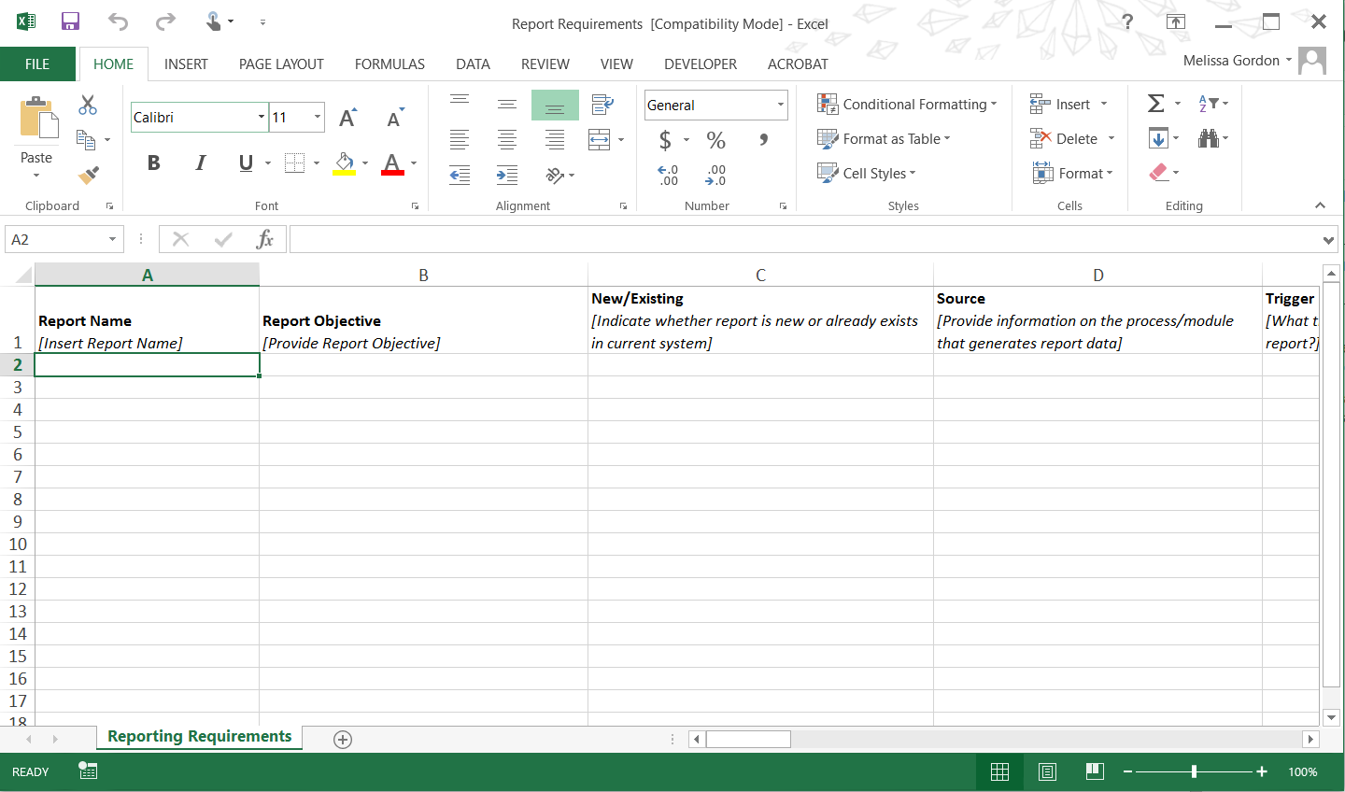
Next Steps / Call to Action Definition of Additional Report Requirements
Needs
Users
“Look and Feel”

Slide 18
The right information in the right hands, at the right time, presented in the most compelling way, yields incredibly golden results. But, even the right information presented too late, to the wrong people, or with too much complexity will not create business value.
For further questions, inspiration, or assistance contact mgordon@katanasoft.com

